Slide 1
Initial Project Ideas
Ivan Garcia
Minecraft Refinery
Drone Flight Stabilizer
Automatic Pet Feeder

Slide 2
Minecraft Refinery:
In a minecraft world I have right now, I have a refinery which combines acetaldehyde with creosote oil to make phenolic resin. I need this to make other items in the game, but I need to be careful not to accidentally produce too much resin or have too much acetaldehyde flow into the refinery. Overall this process would be made much easier with control system to limit liquid flow. While there are many steps before and after this process, I believe looking at the the controlled flow of acetaldehyde(input) into the machine, combining with the oil (process), and producing the resin(output) would make a decent system for the project.
1
2
3
4
Context:
Variable Controlled:
The flow of Acetaldehyde into the tank
Controller Benefit:
The controller will limit the flow of acetaldehyde based on the current liquid volume and resin amount as to not overflow the tank or produce more than the desired amount.
Controller Goal:
This will ensure that no acetaldehyde is wasted and that the machine can make the desired amount autonomously
Sensor Needed:
Needs a sensor for liquid in mixing tank and liquid in resin tank.

Slide 3
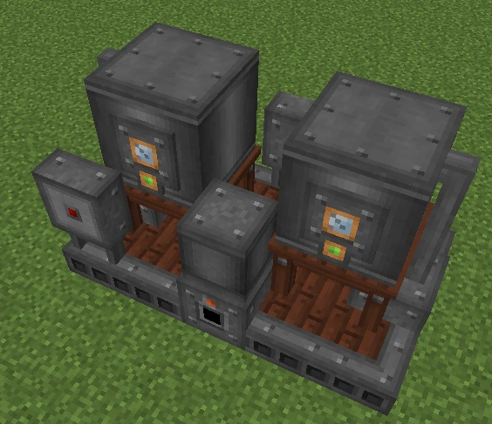
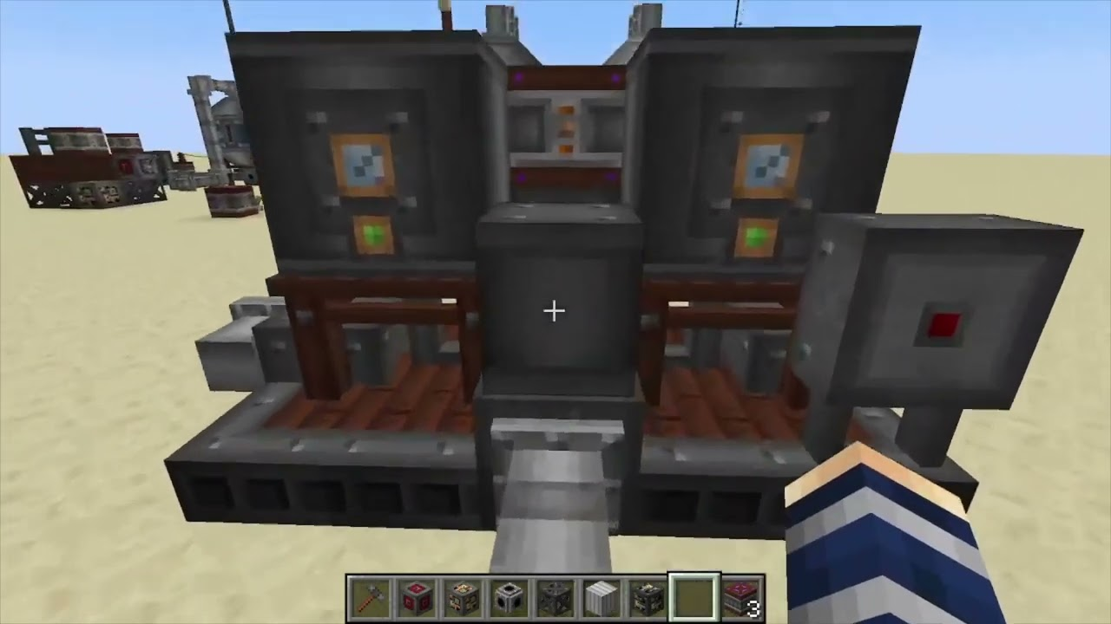
Very basic diagram of the process
L(S)
Controller:
Controls how much liquid flows in
A(S)
Process:
Mixes Ace with oil
A(S)
This is the project I most want to do

Slide 4
Drone Flight Stabilizer:
For a drone to float in air it needs to account for its own movement and slow said movement down. Thus it would take in current speed and increase the thrust in the opposite direction to accommodate said speed. For the sake of simplicity this will only be looking accommodating itself from falling downwards.
1
2
3
4
Context:
Variable Controlled:
The speed of the drone in the vertical direction.
Controller Benefit:
The controller makes it so the drone can properly stabilize itself based on speed intake and minimize overcompensation
Controller Goal:
The controller will allow thrusters or turbines to slow themselves down so it doesn’t fall and doesn’t rise from trying to hard to compensate.
Sensor Needed:
The sensor will take in the speed of the drone(downards)

Slide 5
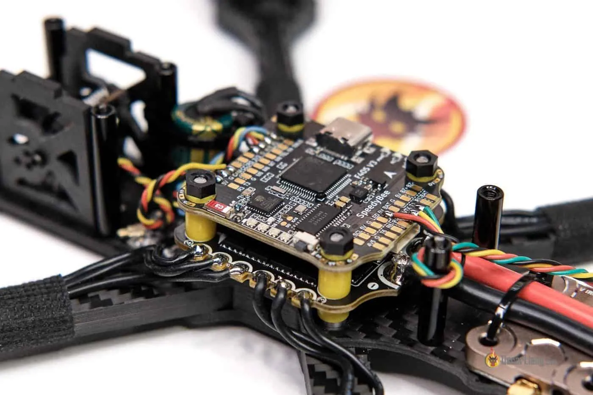
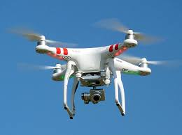
Very basic diagram of the process
V(s)
Controller:
Controls propellor speed based on current speed
y(s)
Calculates speed based on position
This project I want to do the second most

Slide 6
Automatic Pet Feeder:
Sometimes people need to be away from the house, but obviously their pets still need to eat. So a control system which takes in data such as the weight of food in the bowl and time since last dispense can periodically feed pets while the owner is away. Same system could apply for water.
1
2
3
4
Context:
Variable Controlled:
The amount of food let out into the bowl
Controller Benefit:
This allows for the automation of a process in a way that is still healthy for the pets.
Controller Goal:
Will only dispense food so long as an allowable amount of food is in the bowl and enough time has passed since the last feeding
Sensor Needed:
A sensor for bowl weight and a timer would be required.

Slide 7
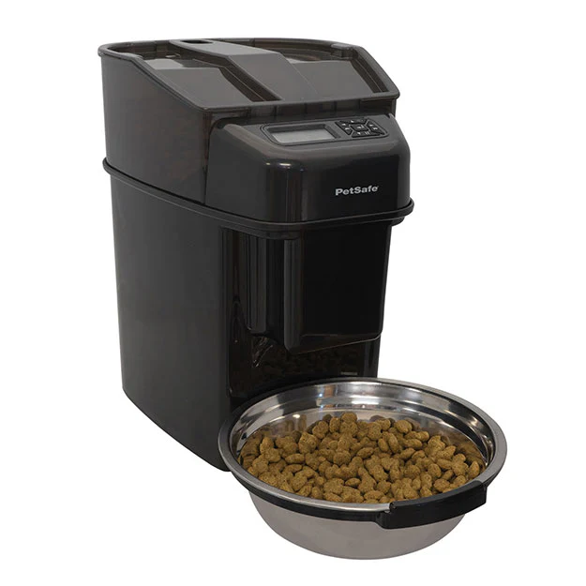
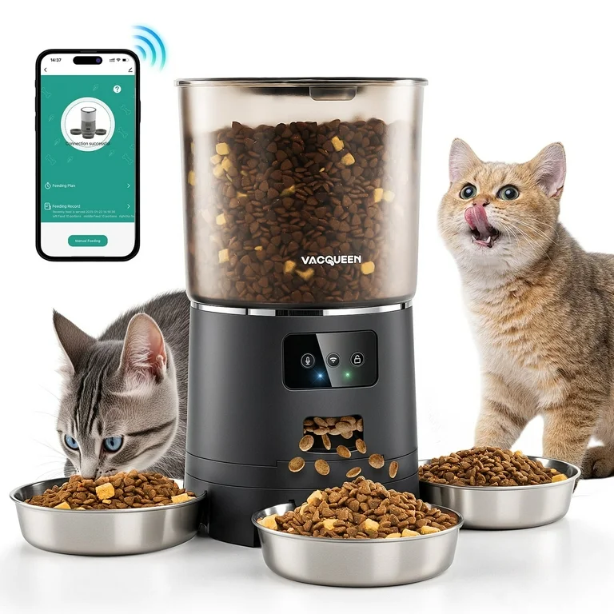
Very basic diagram of the process
Controller:
Controls how much food is poured based on bowl weight and time
W(S)
Process:
Starts timer after sensing weight has reached a certain point
T(S)
F(s)
This is the third project I would want to do

